Slide 1

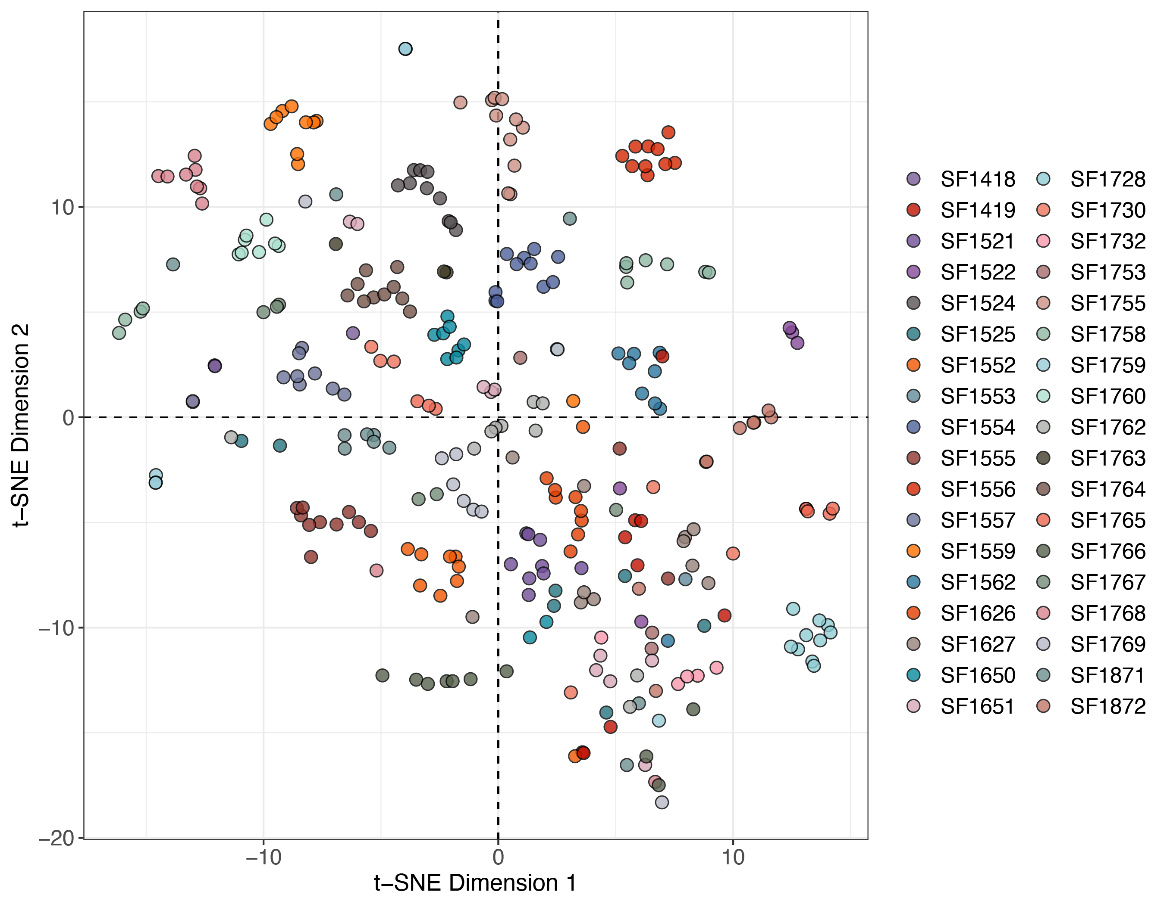
t-SNE analysis (peaks, QC RSD < 30%)
Samples from the same participant tended to cluster together indicating greater individual similarity.

Slide 2
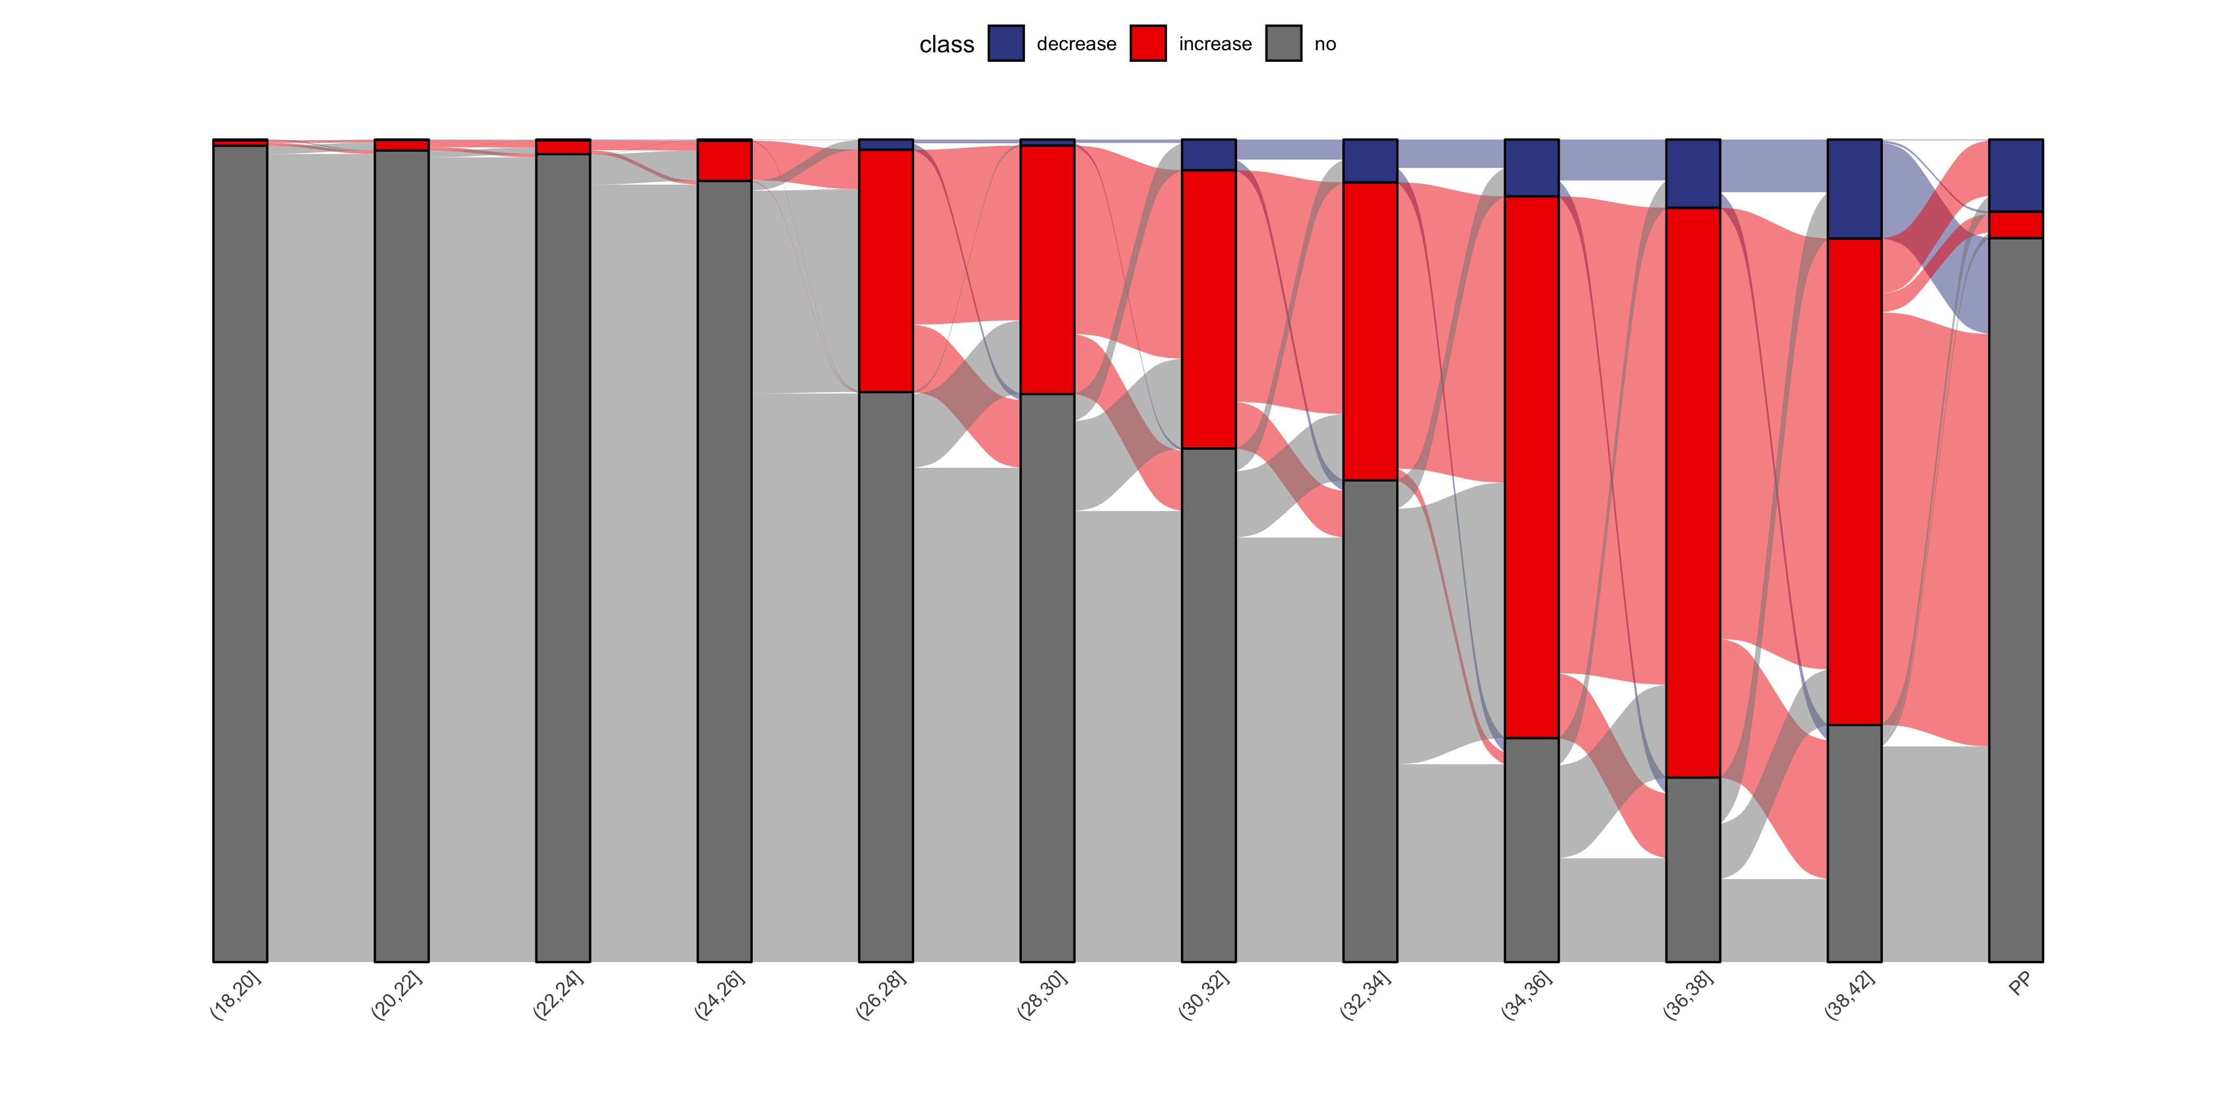
Dysregulated metabolome regulation during pregnancy

Slide 3
Fuzzy K-means clustering

Slide 4
Fuzzy K-means clustering

Slide 5
Fuzzy K-means clustering

